Slide 1

Drop in an image
Kubernetes Security topics

Slide 2
WHOAMI
whoami
DevOps Engineer @ KloudOps
Father of two big cats and soon to be husband.
Minimalism, automation, opensource, to break things.
Music, mountains, vie ferrate, bodybuilding.
Github: github.com/maxgio92
Twitter: twitter.com/maxgio92
Medium: medium.com/@maxgio92

Slide 3
TABLE OF CONTENTS
Table Of Contents
Authentication
Access control
Confidentiality
Audit

Slide 4
Who can talk with me?

Slide 5

Drop in an image
Authentication

Slide 6
AUTHENTICATION
Authentication
Verify and confirm that the presented identity is actually the real one.
Is the main prevention against spoofing which is:
pretending to be an identity who you are not.

Slide 7
In Kubernetes

Slide 8
AUTHENTICATION
Identities in Kubernetes
User
Service account
Cluster-wide
Not for human users
Used by the K8s components (e.g.: the kubelet)
Notes on human users:
Kubernetes does not have objects which represent human users
Human users are assumed to be managed externally (use delegated authentication)
Bound to namespaces
Users managed by the Kubernetes API
Created automatically by the API server or manually through API calls
Tied to a set of credentials stored as Secrets
which are mounted into pods allowing in-cluster processes to talk to the Kubernetes API

Slide 9
AUTHENTICATION
Identities
make
requests
to
API server
A request can be sent from inside or outside the cluster:
Human user typing kubectl
Kubelets on nodes
Members of the control plane
Authenticated API requests are tied to:
User, or
Service account, or
Nothing (anonymous)

Slide 10
How the API server authenticates?

Slide 11
AUTHENTICATION
Authentication
plugins
To authenticate API request Kubernetes uses authentication plugins
Authentication plugins attempt to associate the following attributes with the request:
username: a string which identifies the end user
UID: a string which identifies uniquely and consistently the end user
groups: a set of strings which associate users with a set of grouped user
extra fields: a map of additional information useful for authorizers
All values only hold significance when interpreted by an authorizer.
All values are opaque to the authenticator.

Slide 12
x509 certificates

Slide 13
AUTHENTICATION
x509 certs
Use case:
among
Kubernetes
components
(and not only)
x509 provides a standard for certificates format to claim an identity, for which the Certicate Authority acts as guarantor in a Public Key Infrastructure (PKI).
Kubernetes requires PKI as so:
The CommonName of the certificate is used then as the username.
From | To | Client cert | Kubeconfig | Server cert
kubelet | kube-apiserver | YES | YES | /
* | kube-apiserver | / | / | YES
administrator | kube-apiserver | YES | YES | /
kube-apiserver | kubelet | YES | / | /
kube-apiserver | etcd | YES | / | /
kube-controller-manager | kube-apiserver | YES | YES | /
kube-scheduler | kube-apiserver | YES | YES | /
etcd | etcd | YES | / | YES

Slide 14
AUTHENTICATION
CA protection
CA offloading with Vault
You can manage the root CA externally, if you don’t want to inject the root CA, by creating and injecting only the intermediate CAs for:
kubernetes (general)
etcd
front-proxy
under /etc/kubernetes/pki, and the key pair for Service Account signing.
You could leverage Hashicorp Vault with the PKI Secrets Engine to inject:
intermediate CA certificates with shorter TTL (< 1 year),
which in case of certificates for admin users could be too much.
$ vault secrets enable -path=kubernetes-pki -description="Kubernetes certificate chain" pki
$ vault write kubernetes-pki/roles/admin-role \
allowed_domains="system:kube-scheduler" \
organization="system:kube-scheduler" \
enforce_hostnames=false \
allow_bare_domains=true \
server_flag=false \
client_flag=true \
ttl=1h \
max_ttl=2h
$ vault write kubernetes-pki/issue/admin-role common_name=system:kube-scheduler

Slide 15
Bearer tokens

Slide 16
AUTHENTICATION
Service
Account
token
Use case:
from
workload
to
API server
It’s an authenticator plugin enabled by default that uses signed bearer tokens to verify requests.
The signer private key is the which one specified to the API server argument:
$ kube-apiserver --service-account-key-file=<sa.key>
If not specified, the API server signs the SA tokens with its private key.
Service accounts are automatically created and associated to Pods via the ServiceAccount admission controller, via the specified serviceAccountName field in the pod spec, otherwise the default is used.

Slide 17
AUTHENTICATION
Service Account
A default Service account is automatically created and associated to Pods via the ServiceAccount admission controller.
Custom ServiceAccount can be request to be associated via the specified serviceAccountName field in the Pod spec; otherwise the default is used.
apiVersion: v1
kind: Pod
metadata:
name: my-pod
spec:
serviceAccountName: build-robot

Slide 18
AUTHENTICATION
Token mount
Automatically revoke deleted tokens
The token is mounted by default from the Secret tmpfs volume associated with the ServiceAccount object into pods.
The mout point is at well-known location:
/var/run/secrets/kubernetes.io/serviceaccount
The authenticator associates:
Username: system:serviceaccount:<namespace>:<serviceaccount>
Groups:
system:serviceaccounts
system:serviceaccounts:<namespace>
$ kube-apiserver --service-account-lookup

Slide 19
AUTHENTICATION
Deny authN by default
Disable explicitely
token auto-mount
Disable by default
token auto-mount
That’s ok to enforce policies at the authorization layer, but the authentication layer remains opened by default.
Not all services needs to authenticate to API server.
Per Pod:
spec.automountServiceAccountToken: false
Per ServiceAccount:
automountServiceAccountToken: false
Bad request
…or actually Good request?

Slide 20
AUTHENTICATION
FR #57601
Enable
to disable
by default
token
auto-mount
TL;DR
“The more layers we have to prevent an attack the better”
“If an attacker is able to somehow hack that layer of authz, he has full access”
“/reopen”
“Disabling by default is not backwards compatible, so is not a realistic option until (if) a v2 Pod API is made”
[..] workaround with Initializers [...]
“Creating a new namespace auto-creates a new service token that is set to automount so it's not a viable solution.”
“/close”

Slide 21
AUTHENTICATION
Non-official
prevention:
Karydia
github.com/karydia/karydia
Kubernetes add-on that inverts via mutating admission webhook the following insecure default settings:
disable by default service account token auto-mount
restrict system calls by adding a seccomp profile
disallow privilege escalation:
securityContext allowPrivilegeEscalation=false
restrict network communication:
provides three levels of custom network policy
Limits:
beta
K8s >= 1.15 (yes EKS, you can...)

Slide 22
On top of Kubernetes:
workload authentication

Slide 23
AUTHENTICATION
Between workload services
To establish trust between the parties, below the application layer a mTLS with PKI is there for you.
With mTLS and a proper PKI in place you establish trust and mutual authentication between your services, especially for zero trust networks.
As you don’t have kubeadm for application components you need a system to:
provide the certificates
update the certificates
revoke the certificates
update the pods accordingly
client keypair
trusted CA certs

Slide 24
AUTHENTICATION
mTLS with cert-manager
CSI
cert-manager CSI driver
The Container Storage Interace is a standard for exposing arbitrary block and file storage systems to containerized workloads on container orchestrators.
Third-party storage providers can write and deploy plugins exposing new storage systems in Kubernetes without ever having to touch the core Kubernetes code.
A CSI driver is a storage plugin that can honor volume requests specified on Pods (like Secret or ConfigMap volume drivers).
An experimental CSI driver to manage x509 ephemeral keypairs unique to each pod.
The cert-manager CSI driver leverages the ephemeral inline volumes with CSI driver as the lifecycle of the certificate key pair must match that of the Pod.
Features:
All private keys are stored locally on the node and never leave the node
Unique keypair per application replica
Certificate request spec in-line of the Pod template
Automatic renewal of certificates
Automatic destroy of keypair on Pod’s termination

Slide 25
AUTHENTICATION
cert-manager CSI driver
How does it work?
kind: Deployment
spec:
template:
spec:
containers:
- name: my-frontend
image: busybox
volumeMounts:
- mountPath: "/tls"
name: tls
command: [ "sleep", "1000000" ]
volumes:
- name: tls
csi:
driver: csi.cert-manager.io
volumeAttributes:
csi.cert-manager.io/issuer-name: ca-issuer
csi.cert-manager.io/dns-names: my-service.sandbox.svc.cluster.local
This CSI driver plugin makes use of the CSI Inline Volume feature (beta in v1.16).
Kubernetes version < 1.16 requires the following feature gate set:
$ kube-apiserver --feature-gates=CSIInlineVolume=true
The driver is deployed as a privileged DaemonSet.
The Kubelet will send a NodePublishVolume call (with Pods details from the in-line volume) to the node’s driver.
The driver will generate a private key and a CSR.
The driver will create a CertificateRequest resource and cert-manager will returns a signed certificate.
The driver will write the resulting keypair to that node’s file system to be mounted to the Pod’s FS.
On renewal the driver simply overwrites the existing certificate in path.
When the Pod is marked for termination:
the Kubelet will send a NodeUnpublishVolume call to the driver
the driver will destroy the keypair from the node’s filesystem

Slide 26
AUTHENTICATION
But…
what if I also offload the handshake from application?

Slide 27
Service mesh

Slide 28
AUTHENTICATION
mTLS
with
service mesh
The term service mesh is used to describe the network of microservices that make up such applications and the interactions between them.
As it grows in size and complexity, it becomes harder to manage and also the requirements grow:
end-to-end authentication
access control
observability
service discovery
load balancing
canary rollouts / A/B testing
etc.
Most service mesh frameworks are here to help satisfy these requirements.

Slide 29
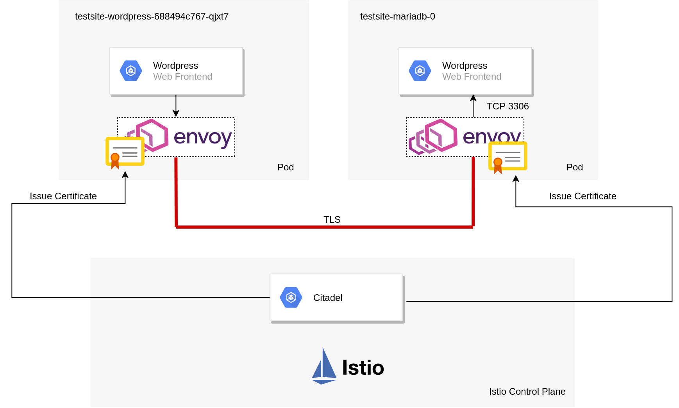
AUTHENTICATION
mTLS with Istio
How does it work
The Istio traffic management model relies on Envoy proxy, deployed as a sidecar.
All the data plane traffic is proxied through it.
The traffic can be authenticated and encrypted trasparently, other than directed and controlled.
Istio other than JWT-based request-level authentication offers peer authentication, used for service-to-service authentication via mTLS.
When enabled between two services, they start and receive the requests in plain text because Envoy manages the TLS handshake.
To start enforcing mTLS incrementally, you need:
server-side: Peer Authentication Policy
client-side: Destination Rule

Slide 30
AUTHENTICATION
Server side: Peer Authentication Policy
Peer Authentication Policies apply to requests that a service receives.
You decide the mode Istio enforces mTLS:
STRICT: require mTLS
PERMISSIVE: accept both mTLS and plain from out-of-mesh services
DISABLED: never require mTLS
You can enforce peer authentication globally or incrementally with policies, by selecting the scope:
mesh-wide (globally)
namespace-wide
workload-specific
# All workloads with the “app=reviews” label
# in namespace “foo” must use mutual TLS.
apiVersion: security.istio.io/v1beta1
kind: PeerAuthentication
metadata:
name: example-peer-policy
namespace: foo # defines the scope
spec:
selector: # defines the scope
matchLabels:
app: reviews
mtls:
mode: STRICT # defines the mode
Is applied the narrowest policy + this priority to each service:
service-specific
namespace-wide
mesh-wide

Slide 31
AUTHENTICATION
Client side: Destination Rules
Destination rules and virtual services are a key part of Istio’s traffic management.
you use virtual services to decide how you route your traffic to a destination
you use destination rules to decide what happens to traffic for that destination
Destination rules are applied after virtual service routing, so they apply to the traffic’s “real” destination.
They let you configure Envoy’s traffic policies such as TLS mode:
DISABLE: plain text request
SIMPLE: TLS connection with client-side only authn
MUTUAL: mTLS with your own certs in place
ISTIO_MUTUAL: mTLS with Istio generated certificates
# It configures a client to use Istio
# mutual TLS when talking to rating services
apiVersion: networking.istio.io/v1beta1
kind: DestinationRule
metadata:
name: ratings-istio-mtls
spec:
host: ratings.prod.svc.cluster.local
trafficPolicy:
tls:
mode: ISTIO_MUTUAL # Istio manages the PKI

Slide 32
Ok, now that I can trust him, what can he do?

Slide 33
Drop in an image
Access control

Slide 34
ACCESS CONTROL
Access
control
The selective restriction of access to a resource.
Is used to prevent information disclosure and tampering.
In relation, authorization is the act of specifying access privileges to resources.
In Kubernetes I want to focus on access to critical data, starting from the main interface endpoint of Kubernetes.

Slide 35
API server

Slide 36
ACCESS CONTROL
The permissions to access to API objects itself are managed via authorization methods in Kubernetes.
But we can implement access restriction to the API server from L2:
we should restrict the availability of the API Server endpoint to a private network
enable tunneling (e.g.: with VPN)
we should enforce access restriction also with firewall rules
up to L7
API
server

Slide 37
Secret API

Slide 38
ACCESS CONTROL
You should apply least privilege and deny by default with RBAC authorization policies, as:
Secrets can be used to gain extra privileges, as for Service Account token Secrets:
pods that can access Service Account token Secrets could run with elevated permissions if those Service Accounts are granted access to permissive PSPs
allow for list (verb) on Secrets allows to inspect the values
a user who can’t read a Secret but can create pods could expose that Secret by via those pods
list and watch all Secrets in a cluster should be reserved only to trusted system components
list and watch all Secrets in a namespace should be avoided
only get requests on the needed Secrets should be allowed to let applications access them.
Secret API

Slide 39
ACCESS CONTROL
The Kubelet can read any Secret from the API server, so:
being able to impersonate the Kubelet enables you to read all the Secrets
So enforce restriction with Node Authorization, which is an authorization mode that specifically authorizes only the API requests that the kubelet needs.
In order to be authorized by the Node authorizer, kubelets must use a credential that identifies them as:
being in the system:nodes group
with a username of system:node:<nodeName>
The value of <nodeName> must match the name of the node as registered by the kubelet
from hostname
or cloud provider metadata API when --cloud-provider is specified
To enable the Node authorizer, start the apiserver with:
$ kube-apiserver --authorization-mode=Node
You can further review kubelet’s permissions with the NodeRestriction admission controller:
$ kube-apiserver --enable-admission-plugins=...,NodeRestriction
Secret API
and
the Kubelet

Slide 40
Secret Volume

Slide 41
ACCESS CONTROL
A Secret volume is used to pass sensitive information to Pods.
A Secret is sent to a node and stored on tmpfs only if a Pod on that node requires it
once the pod that depends on the Secret is deleted, the kubelet will delete its local copy of the secret data as well
only the Secrets that a pod requests are potentially visible within its containers
only containers that request the Secret volume to be mounted can access it.
The prevention can be made by design:
apply single responsibility + least privilege principles
do not expose service that have access to Secrets as much as possible
Secret Volume

Slide 42
ACCESS CONTROL
Secret Volume
Enforce ACL with external providers
External providers AND native integration: CSI drivers
You can integrate external providers like Vault.
Hashicorp provides official integration with Vault-k8s that mimics the native Kubernetes Secret volume behaviour, with:
injector as init container to inject Vault secrets
Vault Agent as sidecar to keep in sync Vault secrets, mounted on a shared tmpfs volume (memory EmptyDIr) on your pods
so that the application access to Vault secrets trasparenlty, by reading from filesystem, without being aware of Vault.
Official
FR #7365: github.com/hashicorp/vault/issues/7365
But the hard part is the authentication.
Unofficial
A solution is KubeVault by AppsCode, which provides:
a Vault Operator
a Container Storage Interface (CSI) driver

Slide 43
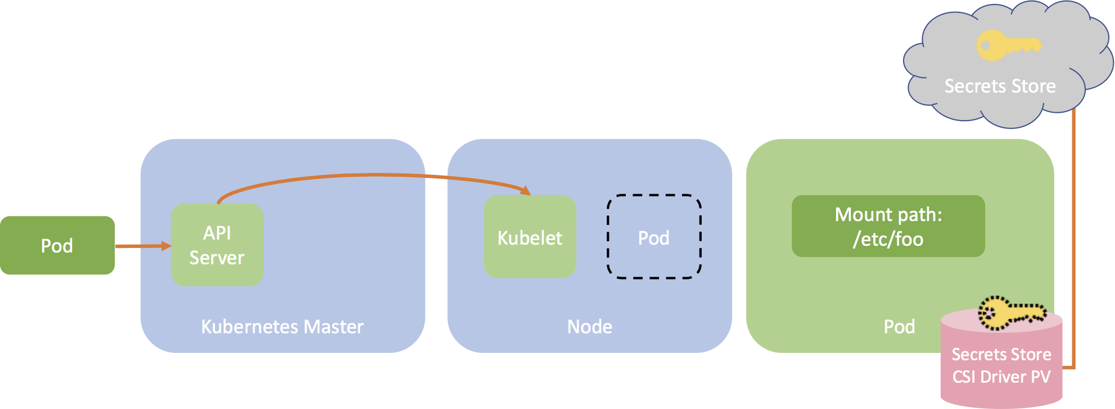
ACCESS CONTROL
Secret Volume
External provider AND more native integration with the Secrets Store CSI driver
You can better integrate using also inline CSI volumes (ephemeral) with the Sig’s Secrets Store CSI driver which:
integrates external secrets stores with native CSI volumes
in combination with third-party secrets stores as CSI providers.
It mounts secrets/keys/certs to pod using a CSI volume
It supports:
CSI Inline volume
mounting multiple secrets store objects as a single volume
pod identity to restrict access with specific identities (Azure provider only)
multiple secrets stores simultaneously as providers
pod portability with the SecretProviderClass CRD
sync with Kubernetes Secrets

Slide 44
Cloud metadata API

Slide 45
ACCESS CONTROL
Consider that:
cloud providers often expose metadata services to nodes.
by default these APIs are accessible by pods running on an instance and can contain:
cloud credentials for that node
or provisioning data (such as kubelet credentials)
these credentials could be used to escalate inside:
the cluster
or the cloud account
How can I prevent?
restrict access to cloud metadata API with Network Policies
apply least privilege to cloud instance roles (e.g.: to IAM instance roles in AWS)
apply single responsibility to cloud application roles
letting different service identities in Kubernetes different roles in the cloud in order to interact with cloud resources (e.g.: use IAM Role for Service Account with EKS in AWS)
Cloud
Metadata
API

Slide 46
ACCESS CONTROL
kind: NetworkPolicy
metadata:
name: example-network-policy
namespace: example
spec:
podSelector:
matchLabels:
role: database
policyTypes:
- Ingress
- Egress
ingress:
- from:
- podSelector:
matchLabels:
role: frontend
ports:
- protocol: TCP
port: 6379
egress:
- to:
- ipBlock:
cidr: 10.0.0.0/24
#- ipBlock:
# cidr: 169.254.169.254/32 # AWS metadata API endpoint /latest/meta-data/
ports:
- protocol: TCP
port: 5978
#- procotol: TCP
# port: 80
Network Policy
Restrict access to cloud metadata API
A network policy is a specification of:
how pods are allowed to:
communicate with:
each other
network endpoints.
These policies are implemented by the network plugin.
NetworkPolicy resources:
use labels to select pods
define rules which specify:
what traffic (in and out) is allowed to the selected endpoints/pods.
Notes:
by default, pods accept traffic from any source
instead Pods selected by Network Policies start to reject traffic that is not explicitely allowed by the union of these policies
the policies are additive
the order of evaluation does not affect the policy result.

Slide 47
Operating System

Slide 48
ACCESS CONTROL
Other than Kubernetes resources and cloud resources, also access to operating system resources must be controlled.
Two builtin features helps us:
Security Context
Pod Security Policies
The Security Context defines privilege and access control settings for a pod or container.
Other than request restricted access to workload, you also want to prevent to request unrestriced access, and you this with Pod Security Policies.
The Pod Security Policy controls security aspects of the pod specification on creation and updates.
Operating
system

Slide 49
ACCESS CONTROL
apiVersion: v1
kind: Pod
metadata:
name: example-pod-with-security-context
spec:
securityContext:
runAsUser: 1000
runAsGroup: 3000
fsGroup: 2000
AllowPrivilegeEscalation: false
readOnlyRootFilesystem: true
volumes:
- name: example-volume
emptyDir: {}
containers:
- name: example-container-with-security-context
image: busybox
command: [ "sh", "-c", "sleep 1h" ]
volumeMounts:
- name: example-volume
mountPath: /mnt/data/my-data
Security Context
Restrict access to OS resources
The settings that a Security Context defines include:
UID and GID of the containers;
the allocation of an FSGroup that owns the pod’s volumes (gid and setgid bit);
SELinux context;
AppArmor profiles;
Privileged / unprivileged run;
Linux capabilities;
Seccomp profiles;
Control on privilege escalation, which is allowed when the container is:
run as Privileged
has CAP_SYS_ADMIN capability
Read-only container root filesystem mount

Slide 50
ACCESS CONTROL
Pod Security Policy
Restrict access to OS resources
Pod Security Policies is a cluster-level resource that controls security aspects of the pod specification on creation and updates.
The policy objects define a set of conditions that a pod must run with, in order to be accepted into the system (validation), as well as defaults for the related fields (mutation).
You define conditions on:
Privileged / unprivileged run
Usage of host namespaces
Usage of host networking and ports
Usage of volume types
Usage of the host filesystem
A white list of Flexvolume drivers
The allocation of an FSGroup that owns the pod’s volumes
Requirements for use of a read only root file system mount
UID and GID of the containers
Escalations of root privileges
Linux capabilities
SELinux context
AppArmor profiles
Seccomp profiles
sysctl profile
These conditions are enforced by an admission controller, which is not enabled by default.
The admission controller behaves with deny-by-default posture, so without policies it prevents from creating all pods.
Since the PSP API is enabled independently of the admission controller, you can create the policies before enabling the admission controller.
When the policies are created, the requesting user or service account must be authorized to use the policy, otherwise the admission controller (if enabled) will prevents from creating all pods.
So:
create the policies
and authorize to use the policies
(if not already) enable the admission controller

Slide 51
ACCESS CONTROL
Authorize to use the policy
Pod Security Policy
apiVersion: rbac.authorization.k8s.io/v1
kind: ClusterRole
metadata:
name: example-psp
rules:
- apiGroups:
- policy
resources:
- podsecuritypolicies
verbs:
- use
resourceNames:
- example-psp
---
apiVersion: rbac.authorization.k8s.io/v1
kind: ClusterRoleBinding
metadata:
name: example-psp
roleRef:
kind: ClusterRole
name: example-psp
apiGroup: rbac.authorization.k8s.io
subjects:
- kind: ServiceAccount
name: replicaset-controller
namespace: kube-system
Other than deny you can also allow specific workload to run (for instance) privileged by authorizing specific Service Accounts in specific namespaces to use privileged PSP, instead of the replicaset-controller SA.
Create the policy
apiVersion: policy/v1beta1
kind: PodSecurityPolicy
metadata:
name: example
spec:
privileged: false
readOnlyRootFilesystem: true
allowPrivilegeEscalation: false
runAsUser:
rule: MustRunAsNonRoot
supplementalGroups:
rule: MustRunAs
ranges:
- min: 1
max: 65535
fsGroup:
rule: MustRunAs
ranges:
- min: 1
max: 65535
seLinux:
rule: RunAsAny
volumes:
- '*'
Enable the admission controller
$ kube-apiserver --enable-admission-plugins=...,PodSecurityPolicy

Slide 52
ACCESS CONTROL
The Open Policy Agent is an OSS general-purpose policy engine which provides:
a toolset
a framework
that enables:
unified
context-aware
policy enforcement on the entire stack.
In details it provides:
a declarative language (Rego) to develop policy as code
a simple API.
It decouples policy decision-making from policy enforcement.
Decoupling policy helps you build software services at scale:
makes them adaptable to changing business requirements
improves the ability to discover violations and conflicts
increases the consistency of policy compliance
mitigates the risk of human error.
Open
Policy
Agent

Slide 53
ACCESS CONTROL
Input
{
"servers": [
{"id": "app", "protocols": ["https", "ssh"]},
{"id": "db", "protocols": ["mysql"], "ports": ["p3"]}
]
}
Rego policy
package example
default allow = false # unless otherwise defined, deny
# Rule
allow = true { # allow is true if...
count(violation) == 0 # there are zero violations.
}
# Rule
violation[server.id] { # a server is in the violation set if..
server := input.servers[_]
server.protocols[_] == "http"# it accepts "http" protocol.
}
Open Policy Agent
Policy decisions
It generates policy decisions by evaluating the query input against policies and data
The input can be a representation of your system.
Policy decisions output is not not limited to allow/deny answers, but they can generate arbitrary structured data.
OPA and Rego are domain-agnostic so you can describe almost any kind of invariant in your policies.
Rego lets you encapsulate and re-use logic with rules that are just if-then logic statements.
For example, this policy decision with provided input against policy rule allow will be true

Slide 54
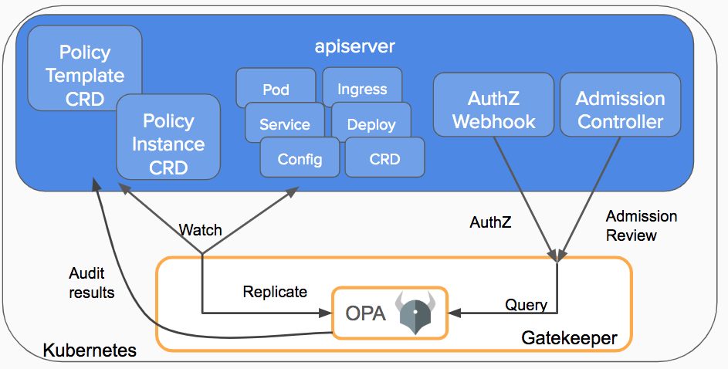
ACCESS CONTROL
OPA Gatekeeper
Kubernetes integration
Gatekeeper is a project that provides integration between OPA and Kubernetes.
OPA Gatekeeper v3.0 adds the following on top of plain OPA:
An extensible, parameterized policy library
CRDs for instantiating the policy library (aka Constraints)
CRDs for extending the policy library (aka Constraint Templates)
Audit functionality.
It is deployed as a validating admission webhook that enforces policies executed by OPA:
on create / update / delete requests the API Server sends the entire Kubernetes object in an Admission Review to the Gatekeeper admission webhook
OPA evaluates the policies it has loaded using the Admission Review as input
during the validation, Gatekeeper acts as a bridge between the API server and OPA
the policies you give to OPA ultimately generate an admission review response that is sent back to the API Server
the API server will enforce the policies.

Slide 55
ACCESS CONTROL
# Prevent from running privileged containers
apiVersion: templates.gatekeeper.sh/v1beta1
kind: ConstraintTemplate # aka policy library template
metadata:
name: k8spspprivilegedcontainer
spec:
crd:
spec:
names:
kind: K8sPSPPrivilegedContainer
targets:
- target: admission.k8s.gatekeeper.sh
rego: |
package k8spspprivileged
violation[{"msg": msg, "details": {}}] {
c := input_containers[_]
c.securityContext.privileged
msg := sprintf("NOT ALLOWED: %v, securityContext: %v", [c.name, c.securityContext])
}
input_containers[c] {
c := input.review.object.spec.containers[_]
}
input_containers[c] {
c := input.review.object.spec.initContainers[_]
}
---
apiVersion: constraints.gatekeeper.sh/v1beta1
kind: K8sPSPPrivilegedContainer # aka policy library instance
metadata:
name: psp-privileged-container
spec:
match:
kinds:
- apiGroups: [""]
kinds: ["Pod"]
# parameters:
OPA Gatekeeper
The Constraint framework
A Constraint (aka Policy Instance) is a declaration that its author wants a system to meet a given set of requirements, evaluated as a logical AND.
A Constraint Template (aka Policy Template) describes:
the Rego logic that enforces the Constraint
the schema for the Constraint, which includes:
the schema of the CRD
the parameters that can be passed into a Constraint.

Slide 56
On top of Kubernetes resources
aka your workload

Slide 57
ACCESS CONTROL
# allow only backend services to
# communicate with Redis service
apiVersion: networking.k8s.io/v1
kind: NetworkPolicy
metadata:
name: access-redis
spec:
podSelector:
matchLabels:
app: redis
ingress:
- from:
- podSelector:
matchLabels:
area: "backend"
Network
policy

Slide 58
Istio’s authorization features provide access control for your workloads in the mesh at:
mesh-wide
namespace-wide
workload-wide
Its authorization system provides these benefits:
Workload-to-workload and end-user-to-workload authorization
A Simple API (a single AuthorizationPolicy CRD)
Flexible semantics that lets you
define custom conditions on Istio attributes
use DENY and ALLOW actions
High performance
Envoy natively enforces it
High compatibility
gRPC
HTTP
HTTPS
HTTP2
plain TCP
How it works?
Each Envoy proxy runs an authorization engine:
a request comes to the proxy
the authorization engine evaluates the request context against the current authorization policies
it returns the authorization result (ALLOW or DENY)
Without an authorization policy applied to a workload: allow by default;
With an authorization policy applied to that workload: deny by default.
Furthermore, deny policies take precedence over allow policies.
ACCESS CONTROL
Service
mesh
authorization
with
Istio

Slide 59
ACCESS CONTROL
Istio
Authorization policy
apiVersion: security.istio.io/v1beta1
kind: AuthorizationPolicy
metadata:
name: httpbin
namespace: foo
spec:
selector:
matchLabels:
app: httpbin
action: ALLOW
rules:
- from:
- source:
principals: ["cluster.local/ns/foo/sa/sleep"]
to:
- operation:
methods: ["GET"]
when:
- key: request.auth.claims[iss]
values: ["https://accounts.google.com"]
An authorization policy object includes:
selector field that specifies the target of the policy
along with the resource namespace
action field that specifies ALLOW or DENY
list of rules that specify when to trigger the action
from field in the rules specifies the sources of the request
to field in the rules specifies the operations of the request
when field specifies the conditions needed to apply the rule
This policy allows:
the cluster.local/ns/foo/sa/sleep service account (the source)
to access with GET HTTP requests (the operations)
the workloads:
with the app: httpbin label
in the namespace: foo
when requests sent (the conditions):
have a Google-issued JWT token (request.auth.claims[iss])

Slide 60
If he could know my secrets, no one should be able to listen our conversation

Slide 61
Drop in an image
Confidentiality

Slide 62
CONFIDENTIALITY
Confidentiality
Confidentiality aims to protect data sent from one sender to a recipient of that data against third parties.
It can be enforced to prevent information disclosure with encryption.
We should consider:
data at rest
data in transit

Slide 63
Data at rest

Slide 64
CONFIDENTIALITY
Let’s start with critical data, which in Kubernetes is mostly represented by Secret objects.
Secrets objects are stored in etcd, but they are encrypted?
No, they don’t, but Kubernetes provides a feature…
Kubernetes encryption at rest
So that the Secrets are not stored in plaintext into etcd, and even if an attacker can gain access to it, he can’t read it.
Which are the requirements?
Kubernetes 1.13
etcd 3.0
How to configure it?
$ kube-apiserver \
--encryption-provider-config <encryption-configuration>
Secret API objects

Slide 65
CONFIDENTIALITY
Kubernetes encryption at rest
EncryptionConfiguration
apiVersion: apiserver.config.k8s.io/v1
kind: EncryptionConfiguration
resources:
- resources:
- secrets
providers:
- aescbc:
keys:
- name: key1
secret: <BASE 64 ENCODED SECRET>
- identity: {}
The configuration is represented by the EncryptionConfiguration API object, part of the apiserver.config.k8s.io API group.
The resources.resources field is an array of resource names that should be encrypted.
The providers array is an ordered list of the supported encryption providers:
identity (default; no encryption)
aescbc
secretbox
aesgcm
kms
On write request for a Secret:
the first provider in the list is used to encrypt this resource (identity by default)
On read request for a Secret:
each key for each provider that matches the stored data attempts to decrypt the data in order.
Warning: if you put the identity provider as the first one you actually disable encryption.
Since the config file can contain encoded data encryption keys:
the encryption could fails to protect against a host compromise.

Slide 66
With envelope encryption the data encryption key that encrypt data is further encrypted with a key encryption key.
Also the key encryption key can be encrypted; BTW eventually a top-level key in plaintext must exists and this is the master encryption key.
Additional features:
the DEK can be generated for each encryption;
the DEK can be stored besides data;
the MEK can be easily rotated;
the MEK can be asymmetrical.
Additional benefits:
performance: as the data can be large the encryption can be time-consuming:
you don’t have to re-encrypt multiple times the data with DEKs
you can re-encrypt only the DEKs
only a key would transit instead of data
CONFIDENTIALITY
Envelope
encryption
FTW

Slide 67
CONFIDENTIALITY
Kubernetes and envelope encryption at rest
EncryptionConfiguration with the KMS provider
The KMS encryption provider uses envelope encryption and lets you offload key/master encryption key to external KMS.
The DEK is generated on each encryption, and the KEK rotation controlled by you.
The KMS provider uses gRPC to communicate with a specific KMS plugin.
The KMS plugin, which is implemented as a gRPC server, communicates with the remote KMS.
Note that if you are using EKS they introduced on March 2020 the support for envelope encryption of Secrets with AWS KMS a little time ago; here the announcement.
apiVersion: apiserver.config.k8s.io/v1
kind: EncryptionConfiguration
resources:
- resources:
- secrets
providers:
- kms:
name: myKmsPlugin
endpoint: unix:///tmp/socketfile.sock
cachesize: 100
timeout: 3s
- identity: {}

Slide 68
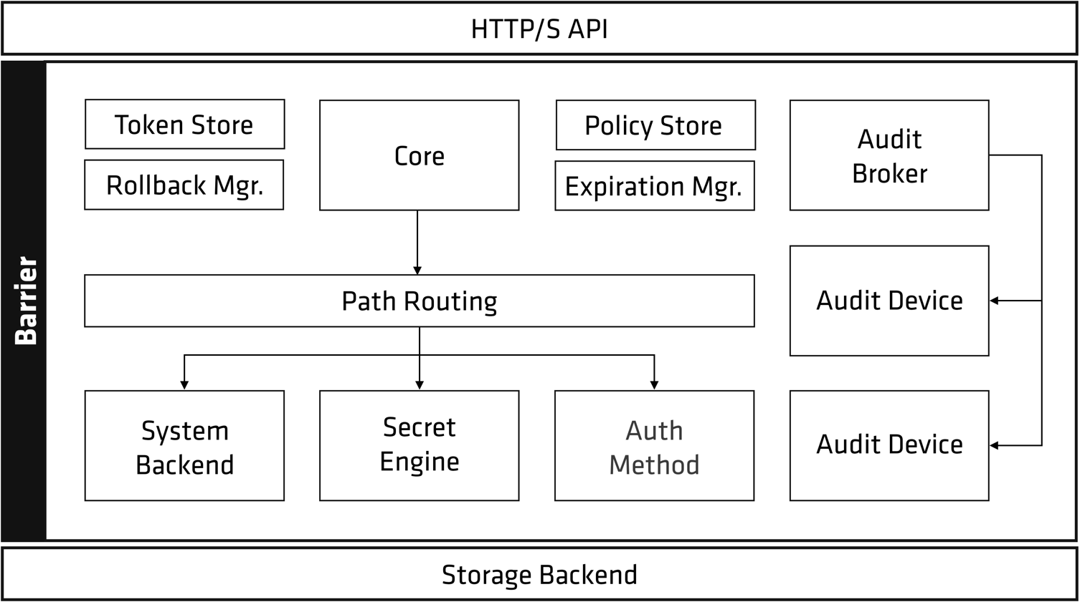
CONFIDENTIALITY
You can also manage secrets without the related Kubernetes API objects and offload secrets management to external systems like Hashicorp Vault.
Vault is a secrets management system and is like a secrets fortress with a powerful architecture.
Let’s focus on the encryption at rest features!
Secret
without
Secret API objects
with
Vault

Slide 69
CONFIDENTIALITY
Vault encryption fortress
The barrier
It’s a cryptographic steel-and-concrete between the storage and Vault.
It ensures that:
the data is encrypted when written out;
that data is verified and decrypted when reading;
There is a clear separation between inside or outside of the barrier.
Only two components are outside the barrier:
storage backend
HTTP API
Storage backend is:
durable storage of encrypted data
not trusted by Vault.

Slide 70
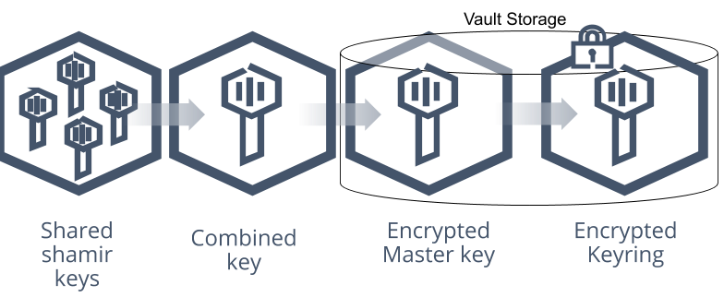
CONFIDENTIALITY
Vault encryption fortress
The seal
Vault implements envelope encryption once started is in a sealed state.
When the Vault is initialized it generates a DEK to encrypt data.
The DEK is stored with the data (in the keyring) and is encrypted by a MEK.
The MEK is stored alongside all other data and is further encrypted by a seal key.
Default seal key: Shamir
The Shamir’s Secret Sharing algorithm splits the key into 5 shards.
A threshold of 3 shards is required to reconstruct the unseal key.
In the sealed state Vault is able to access the physical storage, but not to decrypt the data.
Unsealing is the process of obtaining the plaintext MEK to eventually read the data.
Once unsealed, Vault loads all of the other configurations.

Slide 71
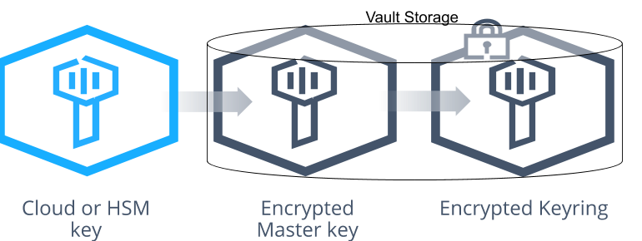
CONFIDENTIALITY
Vault encryption fortress
The auto unseal
Auto unseal lets you delegate seal key protection to external KMS.
At startup Vault will connect to the seal device or service asking to decrypt the MEK in order to read from storage.

Slide 72
CONFIDENTIALITY
Vault in Kubernetes
Recap
Client
Currently there are three ways to injects Vault secrets into Pods:
Hashicorp’s official Vault Injector init container + Vault Agent sidecar which injects into tmpfs shared volume via mutating webhook sidecar injector (mutable solution)
Banzai Cloud’s Vault Injector init container which injects into your container environment variables (immutable solution)
Hashicorp’s Secrets Store CSI driver Vault provider via SecretProviderClass Secrets Store CSI API objects
Server
Hashicorp provides an official Helm chart github.com/hashicorp/vault-helm.
Furthermore, the Hashicorp documentation is great.

Slide 73
CONFIDENTIALITY
Obvious but worth say
base64 is an encoding scheme... That’s ok if you version Secrets objects, but encrypt.
For instance, Mozilla’s SOPS is an editor of encrypted files that supports these formats:
YAML
JSON
ENV
INI
BINARY
and encrypts with:
PGP
AWS KMS
GCP KMS
Azure Key Vault
Decouple
Anyway, I prefer to offload secrets management and decouple secrets lifecycle from code versioning.
Version
control
system

Slide 74
Data in transit

Slide 75
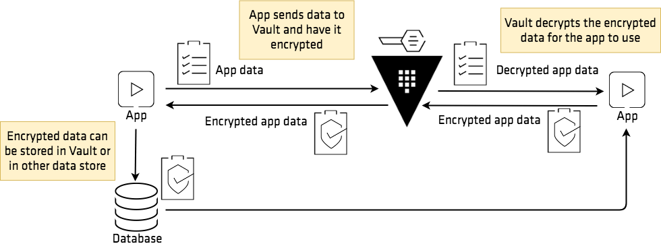
Encryption as a Service
In addition to the encryption of the whole communication, you can and should also encrypt specific part of the L7 payload by leveraging secrets manager like Vault.
Vault provides Encryption as a Service thanks to its Transit Secrets Engine.
A Secrets Engine is responsible for managing secrets.
Secrets Engines support dynamic secrets (generated every time they are required) and static secrets ones as simple K/V objects.
The Transit Secrets Engine handles cryptographic functions on data in transit.
Vault does not store the data sent to the Secrets Engine.
The Transit Secrets Engine can also:
sign and verify data
generate hashes and HMACs of data
act as a source of random bytes.
CONFIDENTIALITY
Between
workload
services
A few
levels
above
TLS

Slide 76
CONFIDENTIALITY
Vault in Kubernetes
Encryption
Decryption
$ curl --header "X-Vault-Token: $VAULT_TOKEN" \
--request POST \
--data '{"plaintext": "<PLAIN_BASE64_SECRET_DATA>"}' \
<VAULT_ADDRESS>/v1/transit/encrypt/orders | jq
{
"request_id": "<REQUEST_ID>",
"lease_id": "",
"renewable": false,
"lease_duration": 0,
"data": {
"ciphertext": "vault:v1:/9hdQutaWpZR72s3+VSCLK1JNhV1wKM49hYVjh7RjmuxIy/OvshtgV4L4uVB+aQ="
}
}
$ curl --header "X-Vault-Token: $VAULT_TOKEN" \
--request POST \
--data '{"ciphertext": "vault:v1:/9hdQutaWpZR72s3+VSCLK1JNhV1wKM49hYVjh7RjmuxIy/OvshtgV4L4uVB+aQ="}' \
<VAULT_ADDRESS>/v1/transit/decrypt/orders | jq
{
"request_id": "<REQUEST_ID>",
"lease_id": "",
"renewable": false,
"lease_duration": 0,
"data": {
"plaintext": "Y3JlZGl0LWNhcmQtbnVtYmVyCg=="
}
}

Slide 77
Anyway, I'm keeping an eye on him

Slide 78
Drop in an image
Audit

Slide 79
AUDIT
Audit we can prevent from repudiation, in order to proove:
what
when
where
why
who
how
on certain actions, by recording them. We generally gain visibility and It also helps to watch for evidence of tampering.
Audit

Slide 80
In Kubernetes

Slide 81
The API server performs audit
For each stage of each request:
generates an event, which is:
pre-processed according to a policy
that determines what’s recorded
written to a backend
persists the records, and can be:
log
static webhook
dynamic webhook
AUDIT
Kubernetes
API
Audit

Slide 82
The available stages for each request to be recorded are:
request received: as soon as the audit handler receives the request;
response started: once the response headers are sent, but before the response body is sent; it’s only generated for long-running requests (e.g.: watch requests)
response complete: the response body has been completed and no more bytes will be sent
panic: events generated when a panic occurred.
Note: with log backend the memory consumption of the API server increases as context required is stored for each request.
AUDIT
Kubernetes
API
Audit
Request
stages

Slide 83
AUDIT
Kubernetes Audit
apiVersion: audit.k8s.io/v1
kind: Policy
# don't generate audit events for all requests
# in RequestReceived stage
omitStages:
- "RequestReceived"
rules:
# log pod changes at RequestResponse level
- level: RequestResponse
resources:
- group: ""
resources: ["pods"]
# don't log requests to configmaps
- level: None
resources:
- group: ""
resources: ["configmaps"]
Enable the policy
$ kube-apiserver --audit-policy-file <policy-file>
Audit Policy
Audit policy defines rules about which events should be recorded.
When an event is processed, it’s compared against the list of rules of the AuditPolicy in order.
The audit levels are:
None, which logs:
no events that match this rule;
Metadata, which logs:
request metadata
not request / response body
Request (it does not apply for non-resource requests), which logs:
event metadata
request body
not response body. This does not apply for non-resource requests.
RequestResponse (it does not apply for non-resource requests) which logs:
event metadata
request body
response body.
The first matching rule sets the audit level of the event.

Slide 84
AUDIT
Kubernetes Audit
Audit Backend
Audit backends persist audit events to an external storage.
BTW audit event is represented by the API resource in the audit.k8s.io group.
Kube-apiserver out of the box provides three backends:
Log: it writes audit events to a file in JSON format
Webhook: it sends audit events to a remote API, which is assumed to be the same API as kube-apiserver exposes
Dynamic: it configures webhook backends through an AuditSink API object.
Events buffering
Both logging and webhook backends support batching for example to buffer events and asynchronously process them (enabled by default in webhook).

Slide 85
AUDIT
Kubernetes Audit
apiVersion: auditregistration.k8s.io/v1alpha1
kind: AuditSink
metadata:
name: mysink
spec:
# audit all events of requests when the response is complete
policy:
level: Metadata
stages:
- ResponseComplete
webhook:
throttle:
qps: 10
burst: 15
clientConfig:
url: "https://audit.app"
Dynamic Audit Backend
With dynamic backend you can provide different audit use cases dynamically.
You can define:
different backends
with different policies
and let them evolve at runtime, regardless of the static policy.
To enable dynamic auditing, kube-apiserver:
--audit-dynamic-configuration=true; # configure audit with dynamic backend
--feature-gates=DynamicAuditing=true; # enable the feature gate
--runtime-config=auditregistration.k8s.io/v1alpha1=true
# enable the API

Slide 86
With systemd
journald
Without systemd
/var/log/kube-apiserver.log
/var/log/kube-scheduler.log
/var/log/kube-controller-manager.log
/var/log/kubelet.log
/var/log/kube-proxy.log
AUDIT
Kubernetes
components
logs

Slide 87
On Kubernetes

Slide 88
As standard streams are communication channels between a program and the environment on which runs:
decouple logging system from the application with stdout/stderr
As a standard interface is likely accepted by OCI compliant and CRI compatible runtimes.
There’s a proposal about how CRI should handle container's stdout/stderr log streams:
github.com/kubernetes/community/blob/master/contributors/design-proposals/node/kubelet-cri-logging.md
For example the Docker json logging driver catches stdout/stderr and writes them into json-formatted files.
At the same way containerd supports log plugins, even if his CRI plugin currently does not support it (issue #1342).
AUDIT
Workload
container
logs

Slide 89
Under Kubernetes

Slide 90
AUDIT
From
Kubernetes
to the
Linux kernel
with
Falco
Falco is an OSS security project part of the CNCF at sandbox level, that can detect and alert on any anomalous behavior that involves making Linux system calls.

Slide 91
Tracing
It traces kernel events via:
kernel module
eBPF probes
ptrace
Parsing and assertion
It ships with policies, which are a set of rules that Falco will assert against.
They can detect unusual behavior in the kernel, such as:
privilege escalation using privileged containers
namespace changes using tools like setns
spawned processes using execve
executing shell binaries
etc.
Alerting
It ships with alerts support, which are configurable downstream actions that can be:
stdout/stderr;
a file;
syslog;
a spawned program;
HTTP/S endpoint.
Furthermore, you can integrate with its API for incident response and mitigation.
AUDIT
Falco
features

Slide 92
Userspace program: this is the program a user interacts with, responsible for:
handling signals
parsing information
alerting.
Kernel driver: this is a piece of software that can send a stream of system call information from the kernel.
Configuration: which defines:
how Falco is run
what rules to assert
how to perform alerts.
AUDIT
Falco
components

Slide 93
AUDIT
The hearth of Falco
- rule: File Open by Privileged Container
desc: Any open by a privileged container. Exceptions are made for known trusted images.
condition: (open_read or open_write) and container and container.privileged=true and not trusted_containers
output: File opened for read/write by non-privileged container (user=%user.name command=%proc.cmdline %container.info file=%fd.name)
priority: WARNING
The condition field is a filter applied to each syscall.
When an event matches, the output field is used to format a notification message.
The rules engine
Because Falco is built on top of Sysdig event processing libraries.
Events are made from syscalls and include the context in which a system call was performed, including:
the process name performing the system call
the process’s parents, grandparents, etc.
the remote IP address to which the process is communicating
the directory of the file being read/written
the current memory usage of the process
etc.

Slide 94
It’s time to break something...

